Slide 1

The Third IEEE International Contest on Software Testing (ISTC)
Tutorial & Practice Guide

Slide 2
Register a MOOCTEST Account

Slide 3
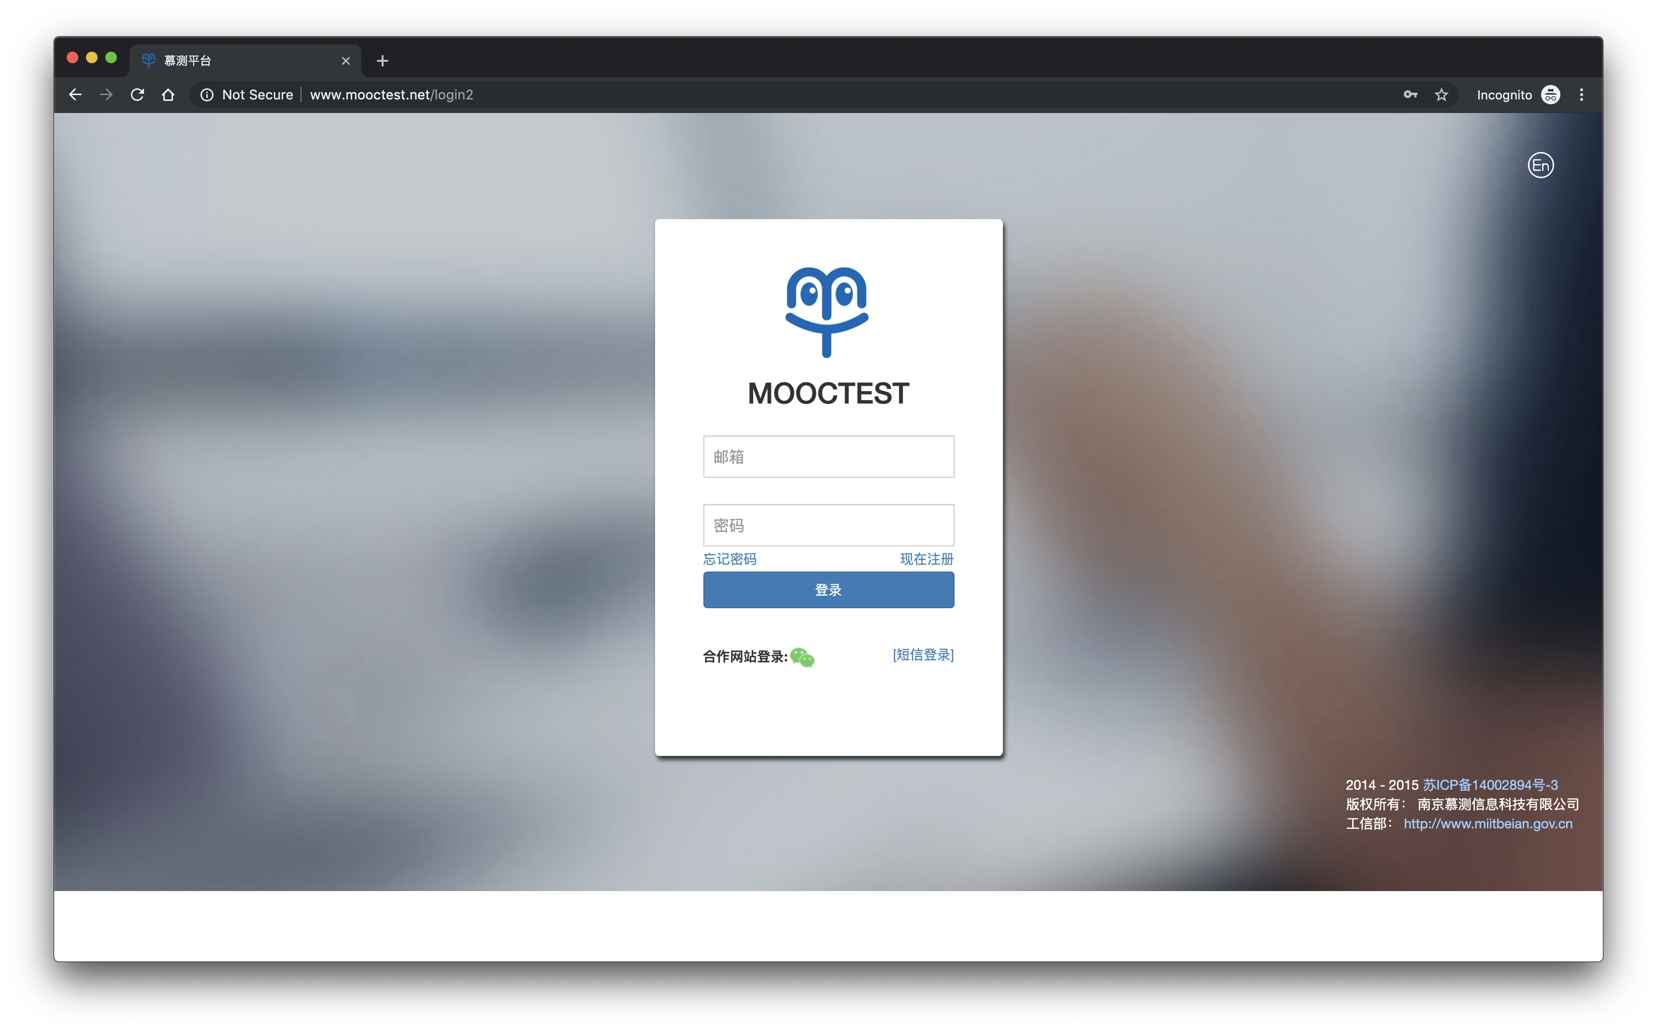
1. Go to website (www.mooctest.net) and change the language to English by clicking the button on the top right corner

Slide 4

2. Click register

Slide 5
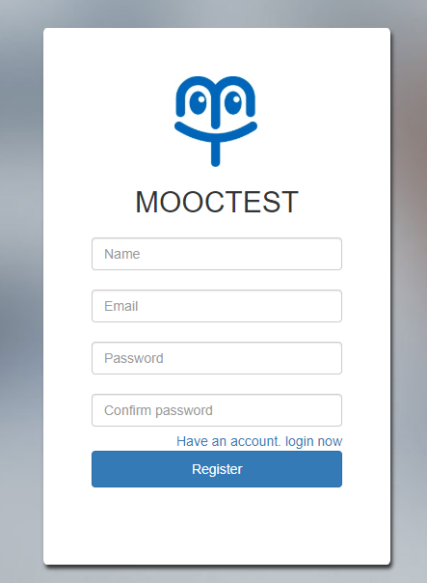
3. Register using your real name and email

Slide 6
Practice via Sample Programs

Slide 7
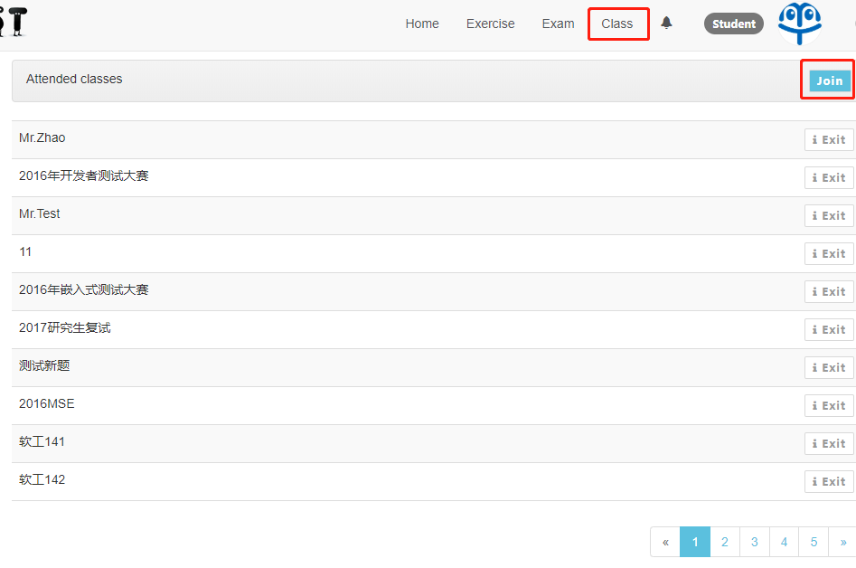
1. Login your account and click “Join” button in “Class” page

Slide 8
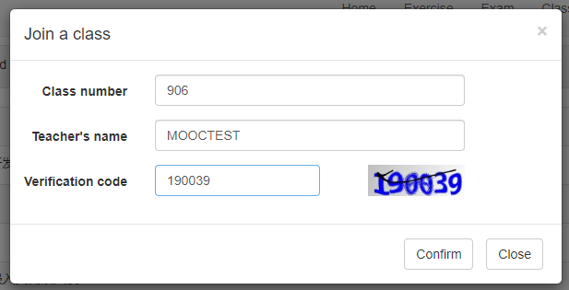
2. Enter Class number: 906 Teacher’s name: MOOCTEST

Slide 9
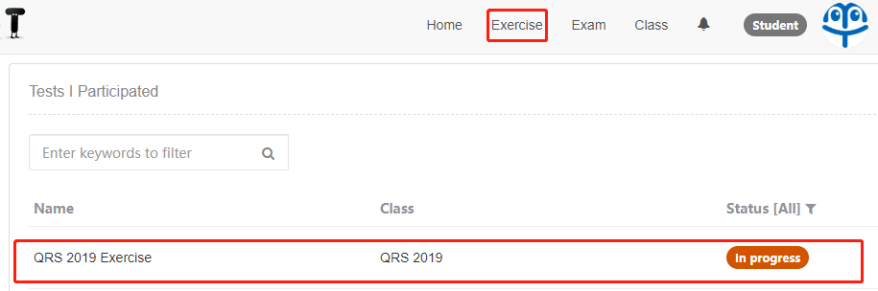
3. Click “QRS 2019 Exercise” in Page “Exercise”

Slide 10
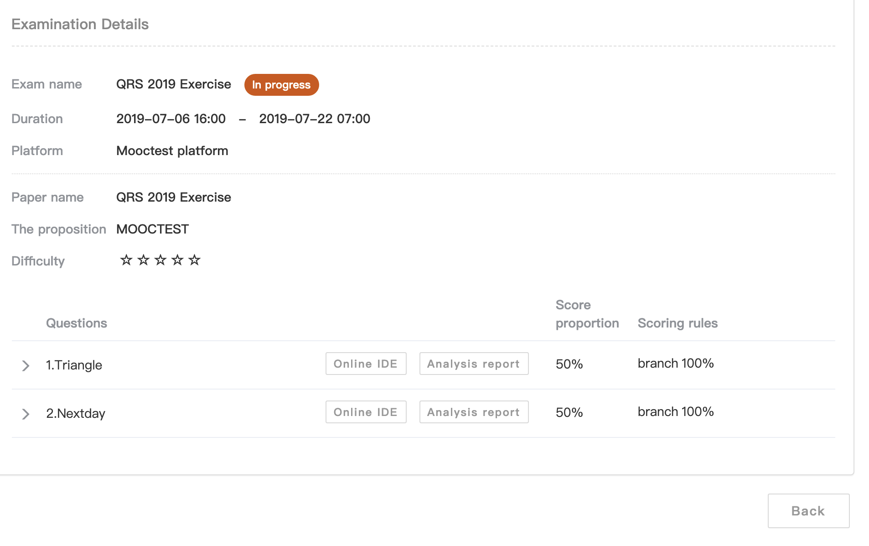
4. Click either one of “Online IDE” buttons to launch Web IDE

Slide 11
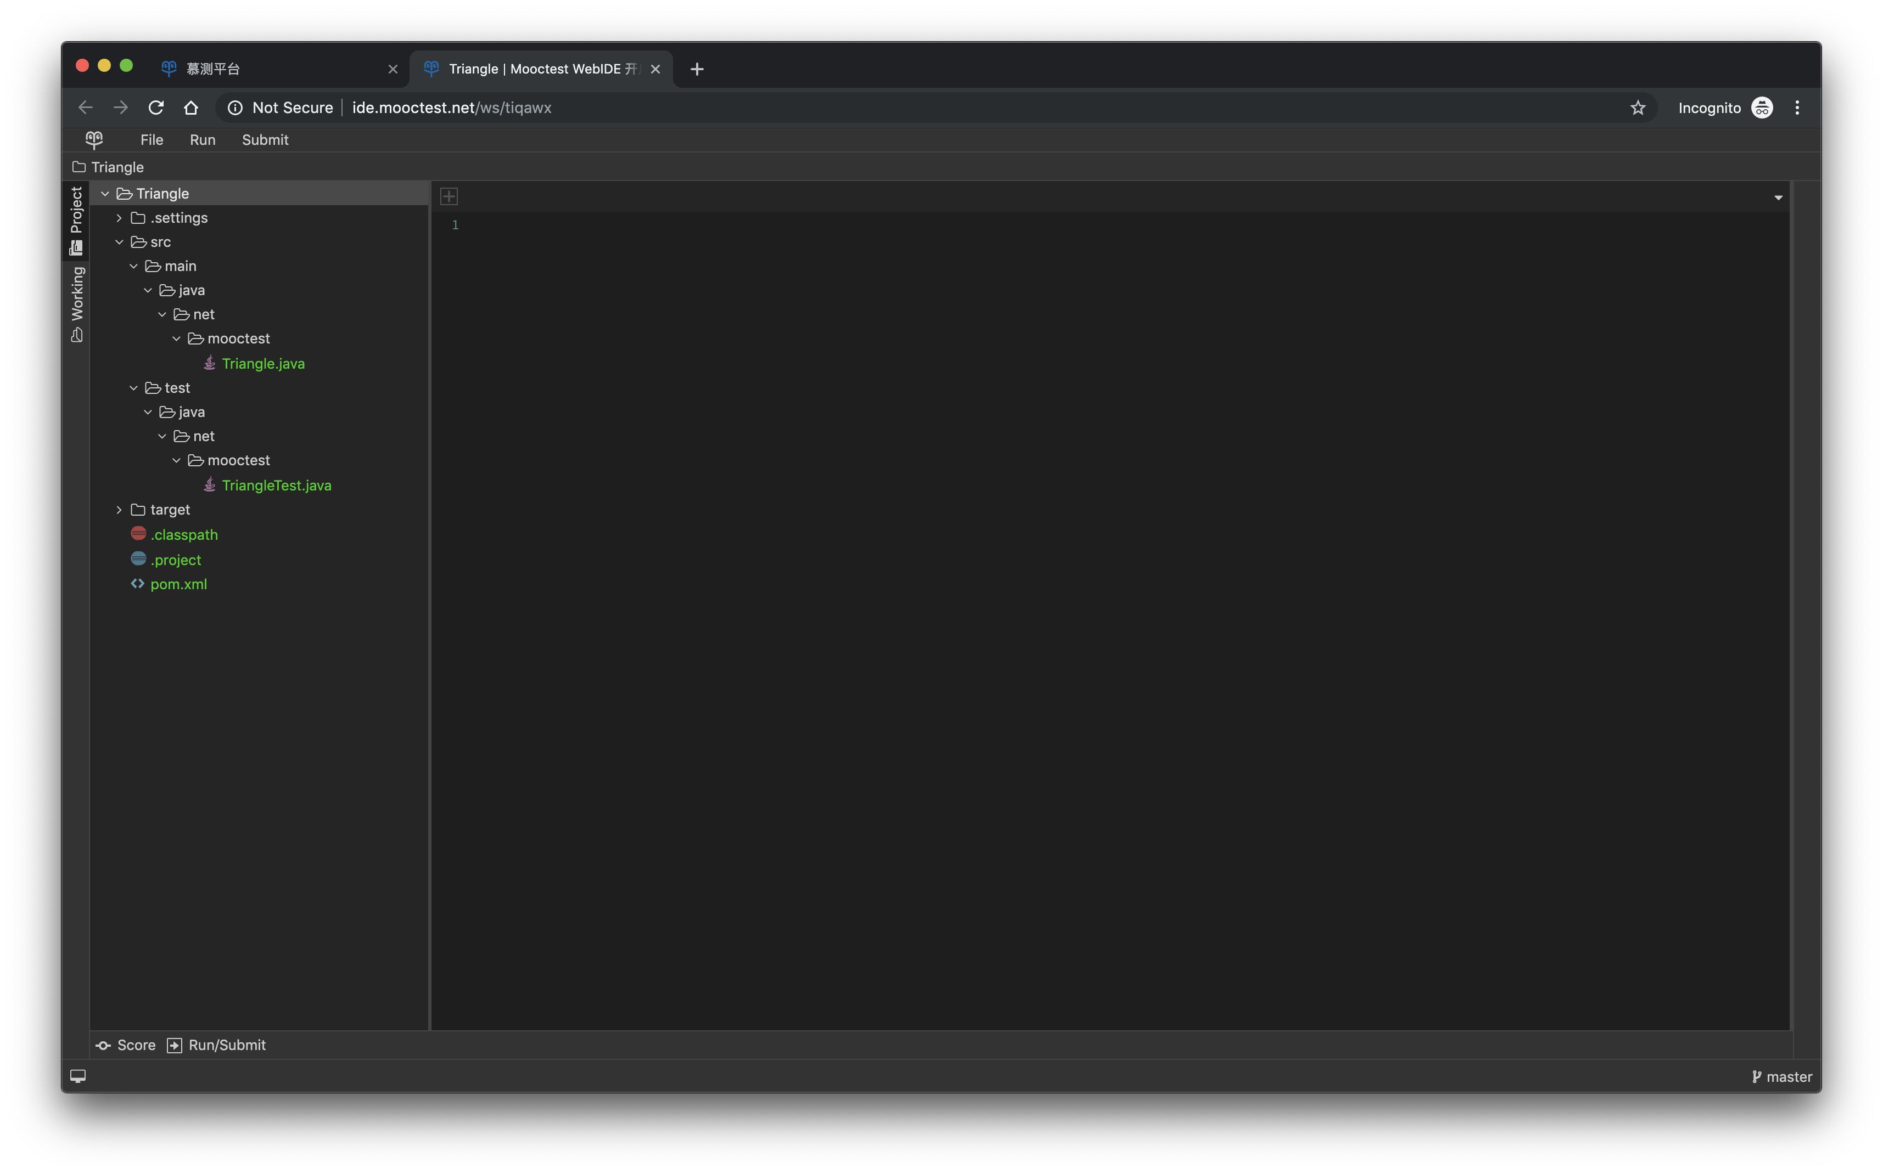
5. The user interface of the Web IDE

Slide 12
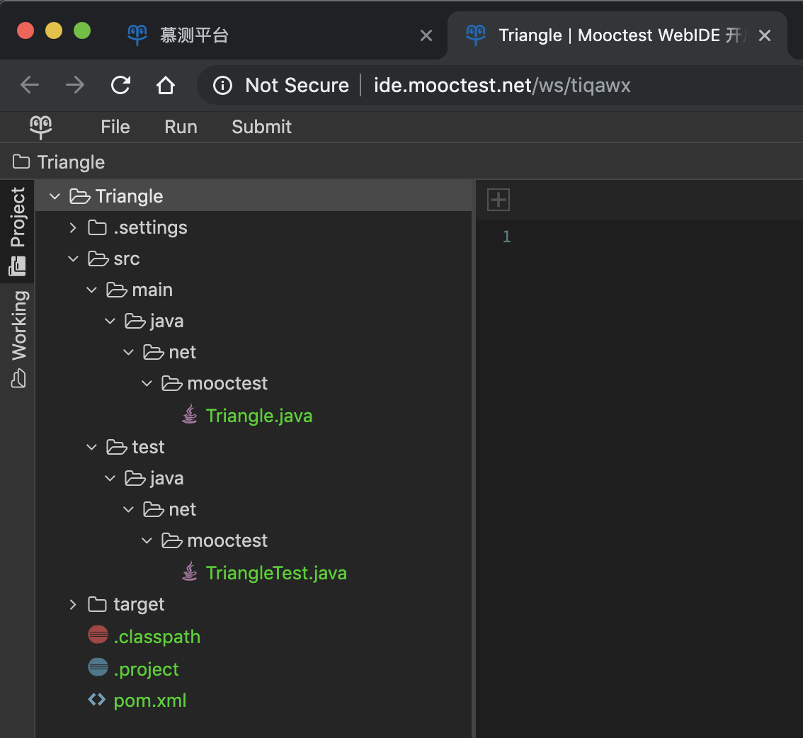
6. The folder structure of the testing project
The source code of the programs you are going to test
The testing source file where you implement your own test cases

Slide 13
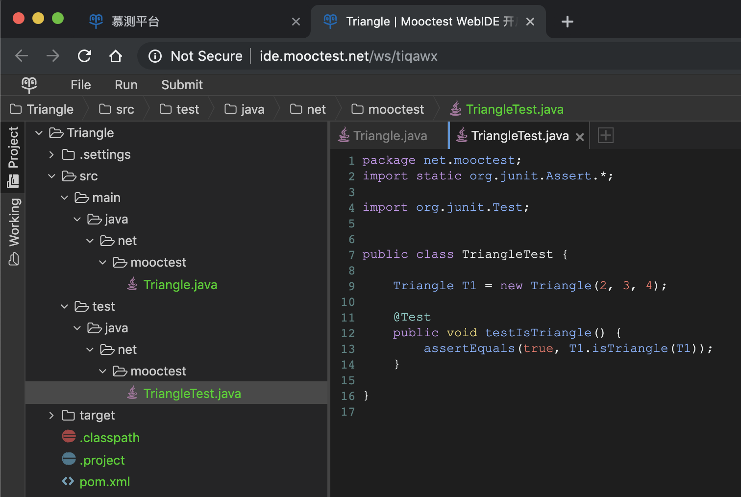
7. The test cases
Write your test cases using JUnit assertions.
E.g., The default test case calls “isTriangle” function and verify its return value.
The assertion is required to evaluate your mutation score.
More information about the branch coverage and mutation score can be found at here

Slide 14
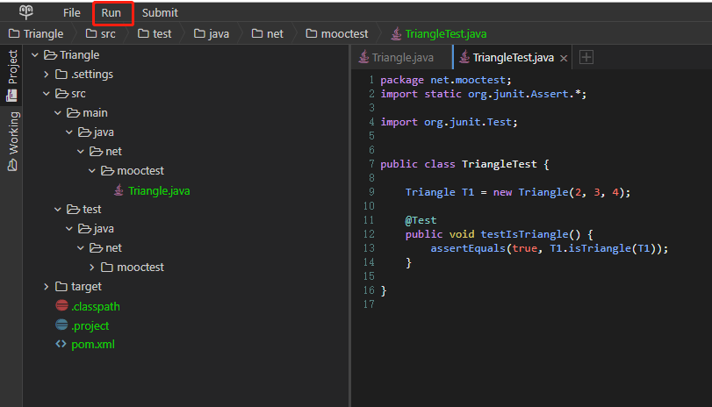
8. Click “Run” button to execute your test cases

Slide 15
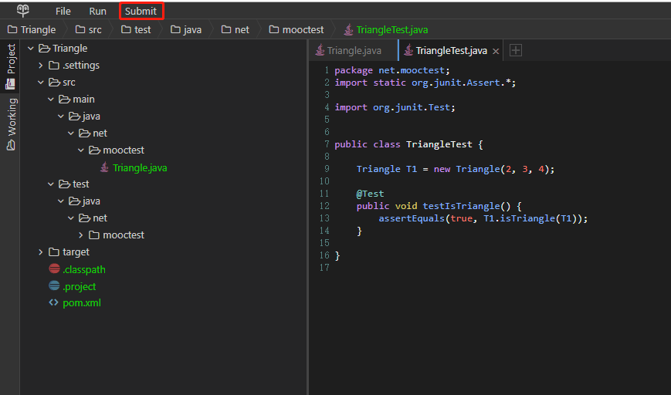
9. Click Button “Submit” to submit to the server (Clicking Submit button will upload your file to the server, while clicking Run button will not. Submit will be slower than Run)

Slide 16
10. Make sure that you click Submit at least once before the end of the contest

Slide 17
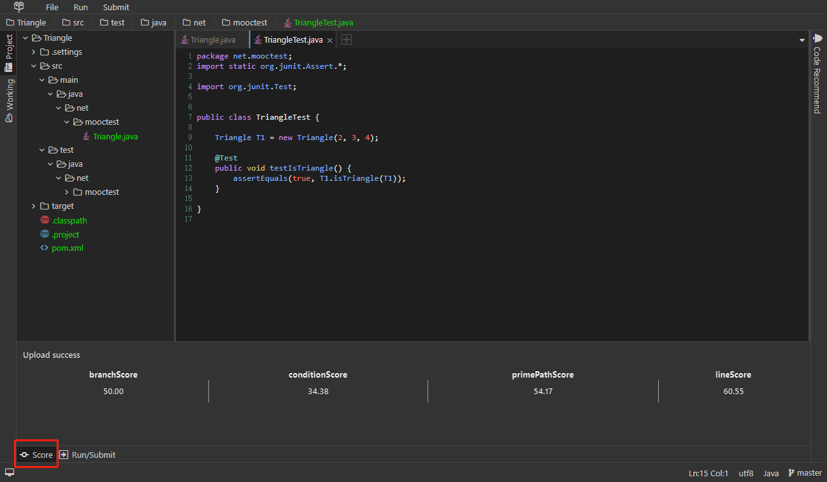
11. Click score to view your current code coverage achievements

